Slide 1
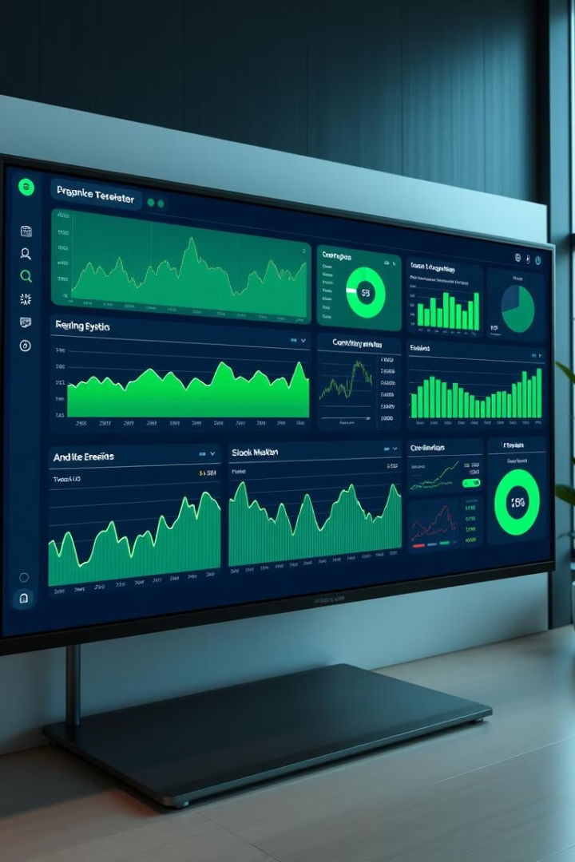
Power BI Desktop Stock Market Analysis Dashboard
-by Ayonika Dutta

Slide 2
INTRODUCTION
The Stock Market Analysis Dashboard provides an overview of stock performance for AAPL, GOOG, MSFT, and NFLX. It includes metrics such as closing prices, opening values, and stock performance over time. Visualizations highlight trends in adjusted closing prices, volume distribution, and high-low comparisons. The dashboard tracks stock movements across different quarters, offering insights into fluctuations and market trends. With bar charts, line graphs, and pie charts, it presents a clear financial snapshot, aiding data-driven investment decisions. The use of purple tones and structured layout enhances readability and quick analysis of stock performance.

Slide 3
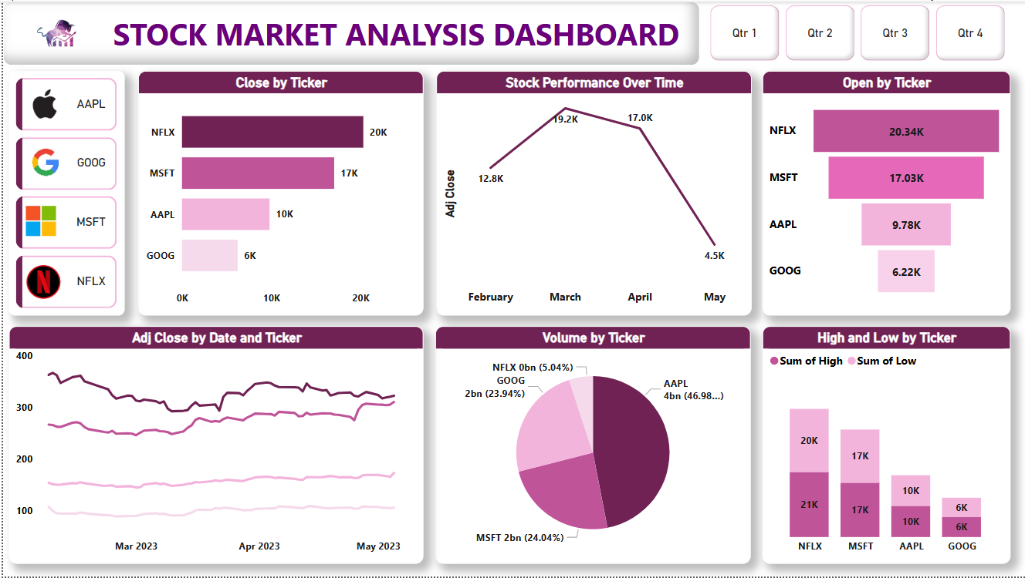
OVERVIEW
This stock market analysis dashboard provides insights into stock performance for AAPL, GOOG, MSFT, and NFLX.
It includes key metrics such as close prices, open prices, adjusted close trends over time, and volume distribution by ticker.
The dashboard visualizes stock performance trends, highlighting variations in high and low prices. A pie chart represents volume distribution, with AAPL holding the largest share. A line graph tracks adjusted close prices over time, showing fluctuations. The interface is color-coded, with quarter filters for deeper analysis, making it useful for monitoring stock trends and making informed investment decisions.

Slide 4
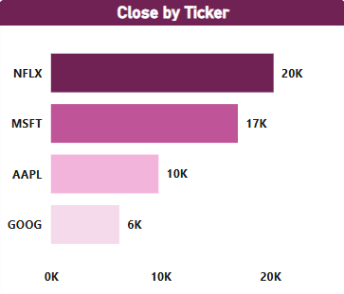
This line chart, titled "Stock Performance Over Time," visualizes the adjusted closing prices across four months: February, March, April, and May.
The adjusted close price starts at 12.8K in February.
It peaks in March at 19.2K, indicating strong performance.
A slight decline in April to 17.0K suggests minor correction.
A sharp drop to 4.5K in May indicates a major downturn.
This trend suggests a strong rally followed by a sharp decline, possibly due to external market conditions or company-specific events. Further analysis is needed to understand the cause of the May drop.

Slide 5
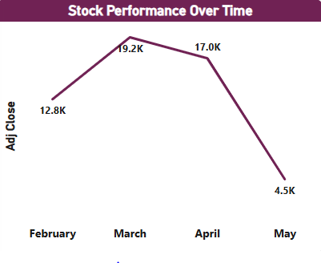
This bar chart, titled "Close by Ticker," presents the closing stock prices for four companies: Netflix (NFLX), Microsoft (MSFT), Apple (AAPL), and Google (GOOG). The values are represented in thousands (K), with NFLX having the highest close at 20K, followed by MSFT at 17K, AAPL at 10K, and GOOG at 6K. The bars are color-coded in shades of purple, with darker shades representing higher values. The chart effectively visualizes the comparative closing values, showing that NFLX and MSFT have significantly higher closing prices than AAPL and GOOG.

Slide 6
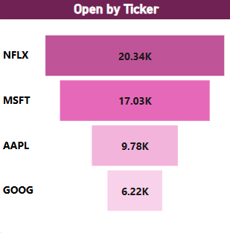
This "Open by Ticker" bar chart visualizes the opening stock prices for four companies: Netflix (NFLX), Microsoft (MSFT), Apple (AAPL), and Google (GOOG).
NFLX has the highest opening price at 20.34K, indicating strong market interest.
MSFT follows at 17.03K, showing competitive performance.
AAPL opens at 9.78K, significantly lower than NFLX and MSFT.
GOOG has the lowest opening price at 6.22K.
The chart suggests that NFLX and MSFT dominate in opening prices, while AAPL and GOOG lag behind. This could reflect investor sentiment or market trends affecting these stocks differently.

Slide 7
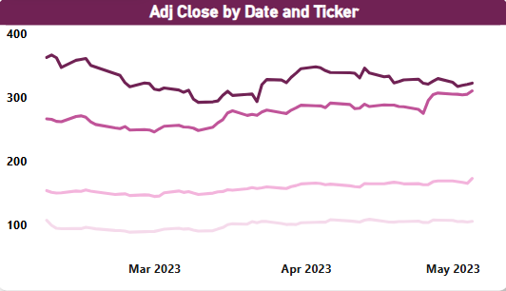
This "Adj Close by Date and Ticker" line chart tracks the adjusted closing prices of multiple stocks over time, from March 2023 to May 2023.
Observations:
The darkest line (highest values) suggests a stock with adjusted close prices fluctuating around 300-400, experiencing some volatility but maintaining an upward trend toward May.
The second line follows a similar trend but remains below the highest stock, indicating a mid-tier performer.
The lower two lines show stocks with significantly lower adjusted close prices but with relatively stable trends.
This chart highlights different performance levels among stocks, with one leading, another following closely, and two lagging behind.

Slide 8
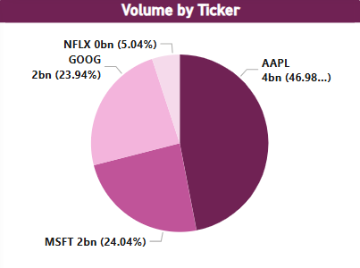
This pie chart represents the trading volume distribution by stock ticker. Key observations:
AAPL has the highest volume at 4 billion (46.98%), dominating the chart.
MSFT and GOOG have similar volumes, around 2 billion (24.04% and 23.94%), respectively.
NFLX has the lowest volume at 0 billion (5.04%).
The chart visually emphasizes AAPL's dominance in trading volume, followed by MSFT and GOOG, while NFLX contributes minimally.

Slide 9
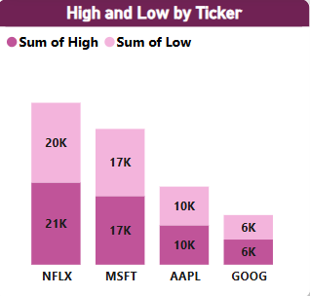
This bar chart displays the sum of high and low values by stock ticker. Key insights:
NFLX has the highest values with 21K (high) and 20K (low).
MSFT follows with 17K (high) and 17K (low), showing a balanced range.
AAPL has 10K (high) and 10K (low), indicating lower variability.
GOOG has the smallest values with 6K (high) and 6K (low).
Overall, NFLX exhibits the highest range, while GOOG has the lowest volatility among the stocks.

Slide 10
CONCLUSION
The dashboard highlights AAPL's dominance in trading volume, NFLX's highest stock price range, and a sharp market decline from April to May. MSFT and GOOG show stable activity, while NFLX exhibits the most volatility. The overall market peaked in March before dropping, indicating a potential correction or bearish trend.

Slide 11
THANK YOU

